Slide 1
Lecture 10
2D plotting & curve fitting
Subplots
Other 2-D Plots
Curve fitting
© 2010 Daniel Valentine. All rights reserved. Published by Elsevier.

Slide 2
Plotting and Curve Fitting
Visualizing trends by plotting large sets of data from experiments or from computer calculations helps you interpret the data. There are numerous grapical tools available in MATLAB.
Curve fitting is a powerful way to use a set of data to find a mathematical model that approximates the set of data.

Slide 3
Subplots
Subplot command allows you to put multiple graphs on one figure window.
subplot(m,n,p) divides figure window
into a grid of m rows and n columns.
Variable p identifies the part of the
window where the plot is placed.
p = 1 | p = 2
p = 3 | p = 4

Slide 4
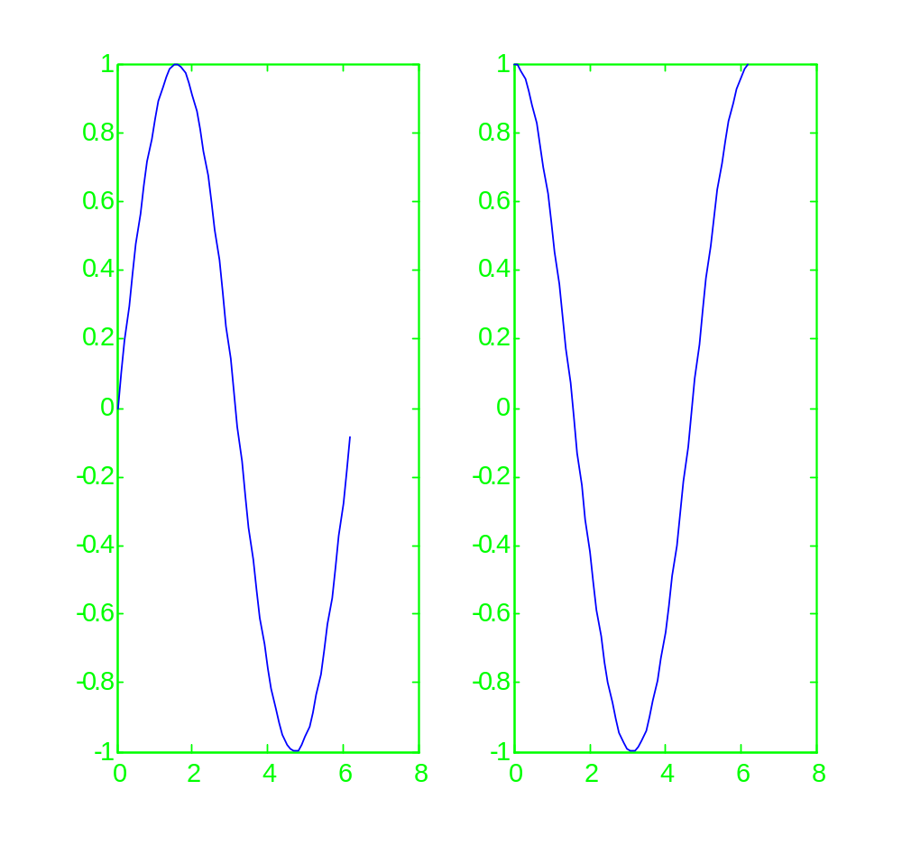





Examples of subplots
To graph sin(x) and cos(x) on the same figure side-by-side do the following:
When a figure with a subplot is open, you must close it before opening a new figure in order for the new figure to display properly.

Slide 5
Other utilities for 2-D plots
MATLAB supports several 2-D plotting utilities:
  Polar plots
  Logarithmic plots
  Bar graphs
  Pie charts

Slide 6
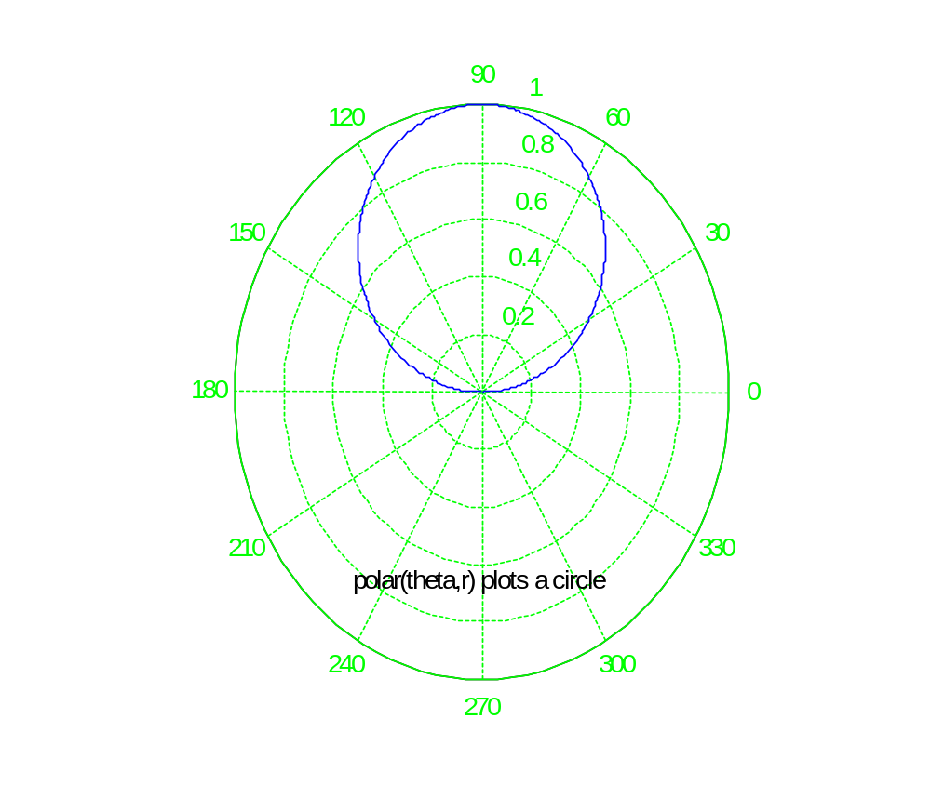
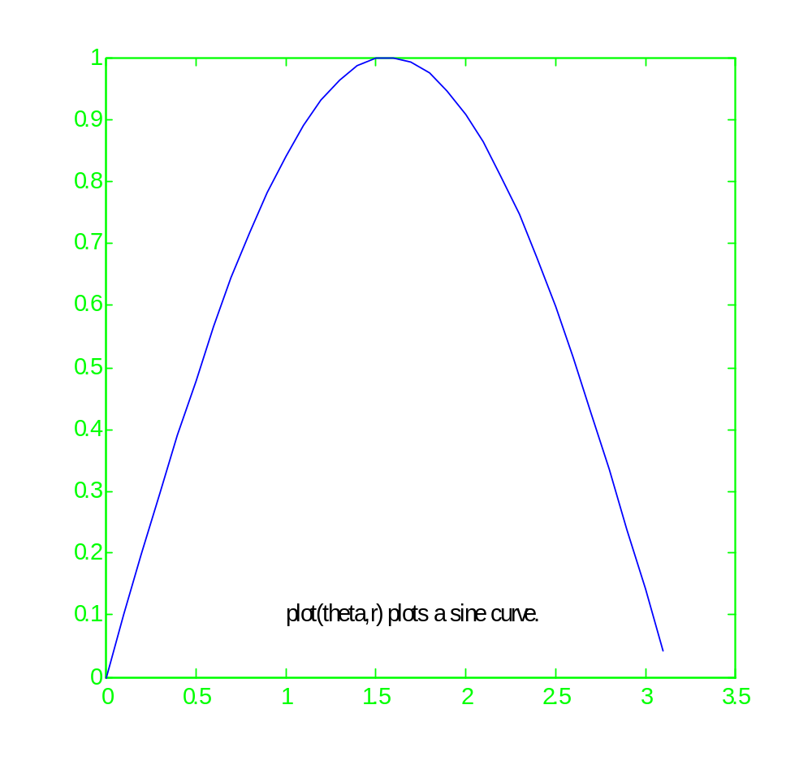




Polar plots
MATLAB supports tools for plotting data in polar coordinates.

Slide 7
Logarithmic plots
MATLAB has tools for three kinds of logarithmic plots:
  semilogx
  semilogy
  loglog
These pltting utilities automatically replace linear scales with logarithmic scales.
Logarithmic scales are useful when a variable ranges over many orders of magnitude.

Slide 8
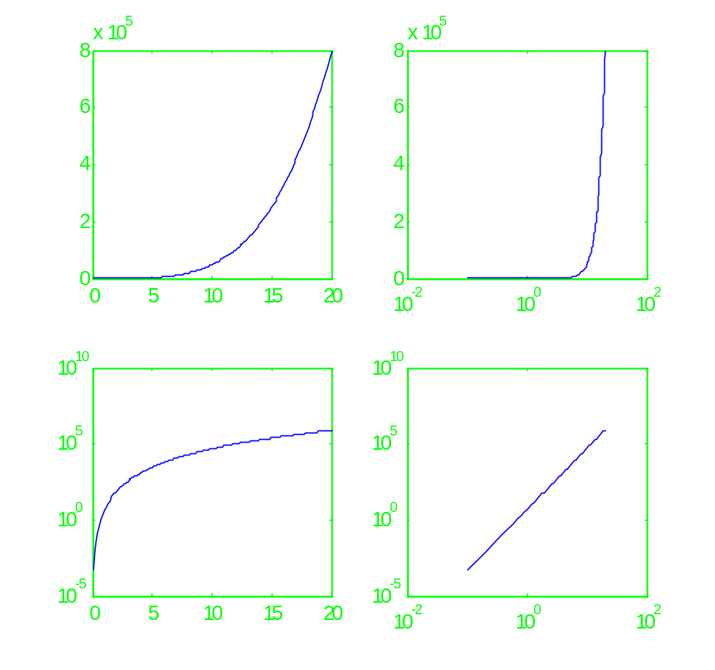










Example: Logarithmic plots & subplots

Slide 9
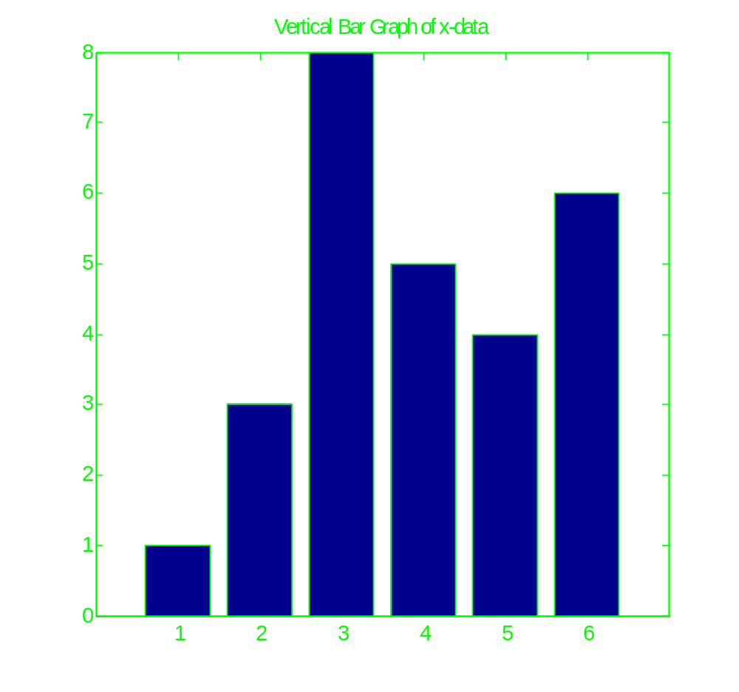
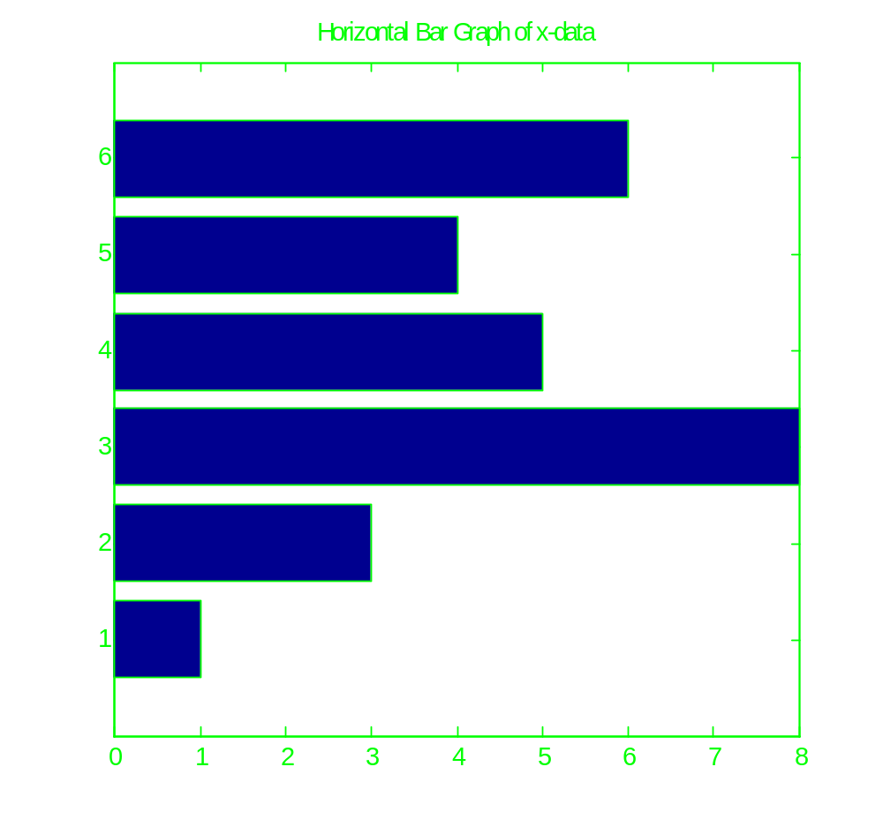
Bar charts
Bar graphs are useful for reporting data.
x = [1,3,8,5,4,6];
bar(x); generates
a vertical bar graph.
barh(x); generates
a horizontal bar graph.

Slide 10
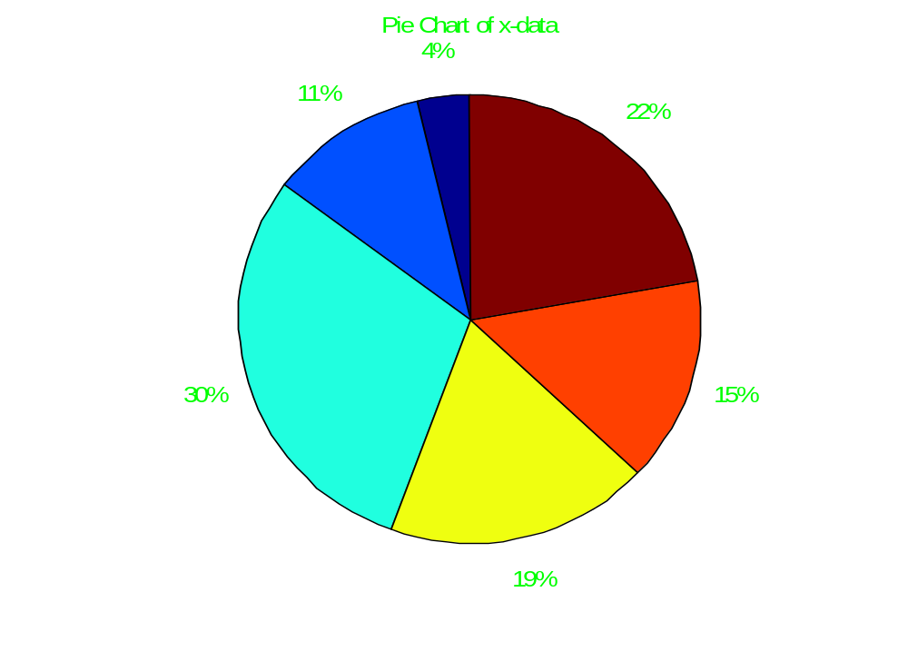
Pie charts
Pie charts are another useful way of reporting data.
pie(x);
8/(1+3+8+5+4+6) ≈ 30%
(cyan section)
5/(1+3+8+5+4+6) ≈ 19%
(yellow section)
etc.

Slide 11
Curve fitting
The simplest way to fit a set of 2D data is a straight line.
Linear regression is a method of fitting data with a straight line.
Linear regression minimizes the squared distance between data points and the equation modeling the data points. This prevents positive and negative “errors” from canceling.

Slide 12
Linear approximation by hand
x = [0,1,2,3,4,5]
y = [15,10,9,6,2,0]
slope ≈ (y₂-y₁)/(x₂-x₁) = (0-15) / (5-0) = -3
Crosses y axis at 15 (note the point (0,15) in our data)
y_{hand} = -3x + 15
sum_of_squares = sum((y - y_{hand}).^2) = 5

Slide 13
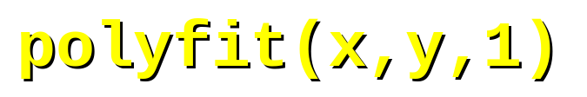
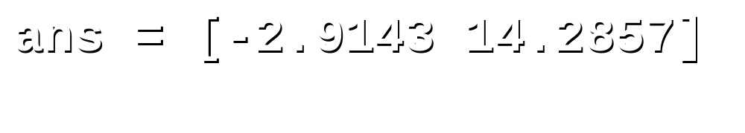
polyfit function
The polyfit function takes (x, y) data, and the degree n of a polynomial as input. It returns the coefficients of the polynomial of degree n that best fits the data.
Using our data:
So, y_{LR} = -2.9143x + 14.2857
sum_of_squares2 = sum((y_{LR} - y).^2) = 3.3714

Slide 14
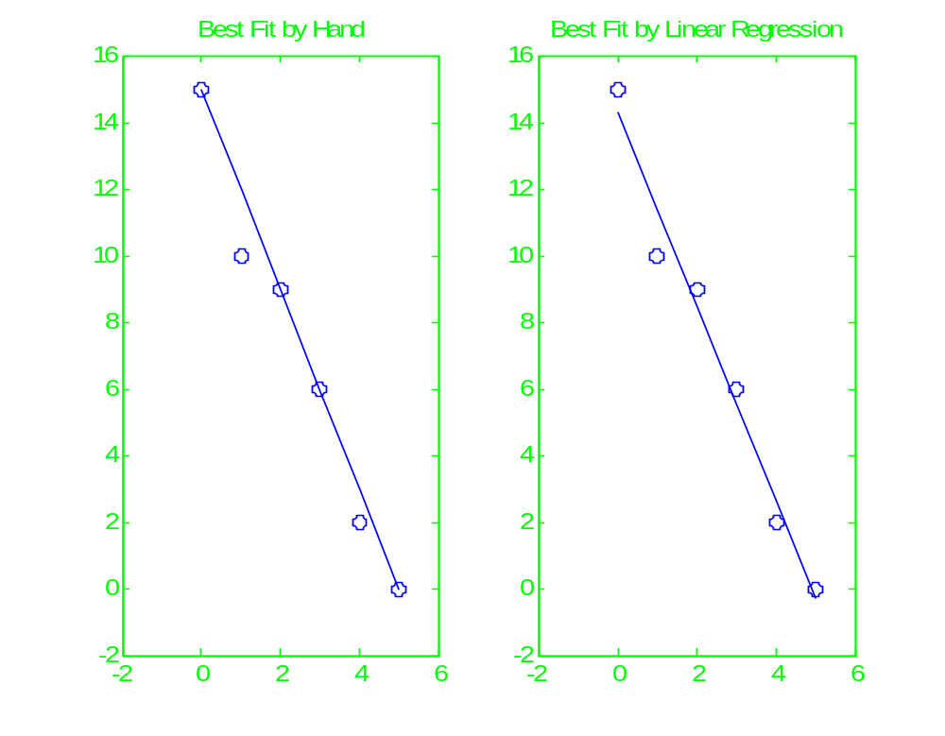
Best Fit Comparison

Slide 15
Polynomial regression
Polynomial regression is used to fit a set of data with a polynomial.
The polyfit function can be used to find the best fit polynomial of a specified degree; the result is the coefficients.
Warning: Increasing the degree of the best fit polynomial can create mathematical models that may fit the data better, but care must be taken in your interpretation of the result.

Slide 16
polyval function
polyfit returns the coefficients of a polynomial that best fits the data.
To evaluate the polynomial at any value of x, use the polyval function.
polyval requires two inputs: the array of coefficients and the array of x-values at the locations the polynomial is to be evaluated.

Slide 17
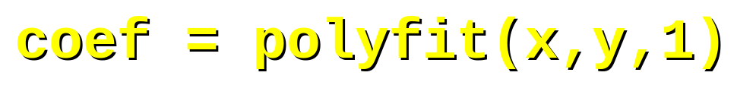
Example using polyval
Referring to the data from this lecture that we used from the polyfit example:
Now try plotting fitted_data vs. x and y_{LR} vs. x. Identical graphs are generated.

Slide 18
Exercises
Use subplots to create normal and polar plots of y = cos(x) + sin(x) in the same figure window for –π ≤ x ≤ π.
Use polyfit to find a 3rd degree polynomial to fit the following set of data:
x = -5:1:4
y = [-506.6, -262.88, -99.43, -36.78, 6.2, 7.11, 16.6, 51, 183, 427.97].
  Plot the best fit curve and the data points on the same figure.

Slide 19
Summary
Example usage subplots
Other 2-D plots: polar and logarithmic
Bar charts and pie charts
Curve fitting
  Linear regression concept
  polyfit function
  polyval function

